Slide 1


Wave Function Matching for solving Quantum Many Body problem
Young-Ho Song (IRIS, IBS)
NLEFT collaboration
2024.04.18. IRIS-CENS meeting

Slide 2
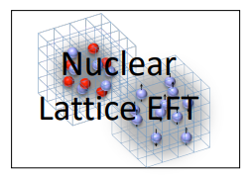
Nuclear Lattice Effective Field Theory Collaboration
Serdar Elhatisari(Gaziantep Islam Science and Technology)
Lukas Bovermann(Ruhr)
Evgeny Epelbaum (Bochum)
Dillon Frame (Juelich)
Fabian Hildenbrand(Darmstadt)
Hermann Krebs(Ruhr)
Timo A. Lähde (Juelich)
Dean Lee (MSU)
Ning Li(Sun Yat-sen)
Bing-Nan Lu( Graduate School of China Academy of Engineering Physic)
Myungkuk Kim(CENS,IBS)
Youngman Kim (CENS,IBS)
Young-Ho Song(IRIS,IBS)
Yuanzhuo Ma(Peking)
Ulf-G. Meißner (Bonn/Juelich)
Gautam Rupak(Mississippi State)
Shihang Shen (Juelich)
Gianluca Stellin( CEA Paris-Saclay)
And More…

Slide 3
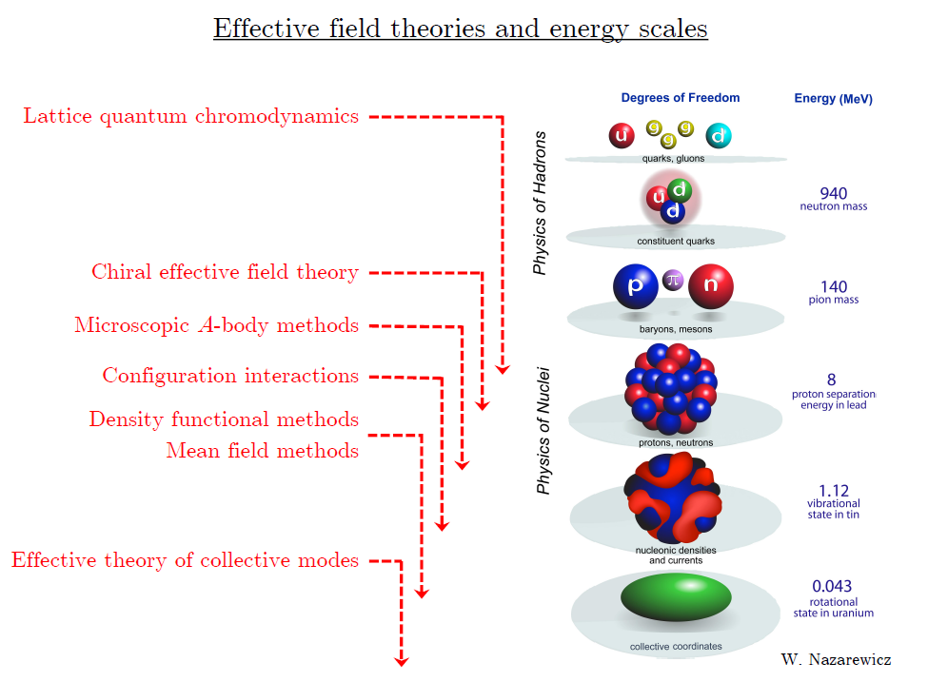
Ab initio
Nuclear
Theory

Slide 4
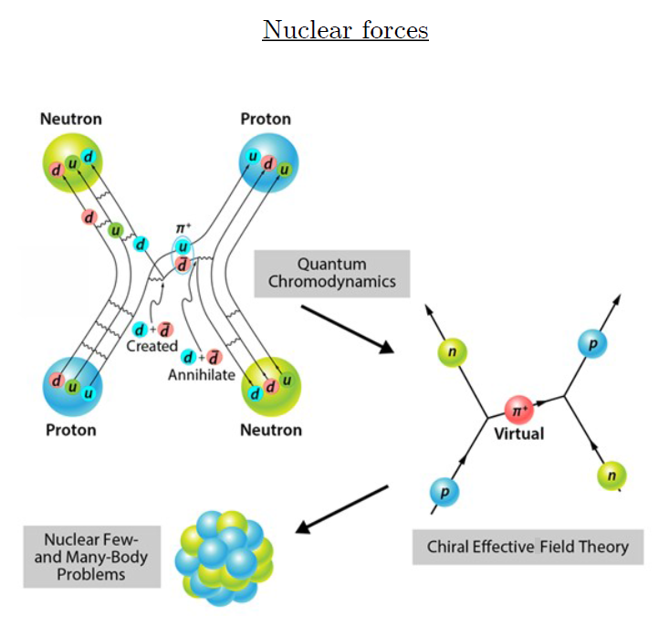
Ab-initio method
ab-initio Nuclear Physics
(1) nucleon degrees of freedom
(2) nucleon-nucleon interaction
Goal: predict wide range(structure, reaction, nuclear matter) of nuclear phenomena (without parameter fitting, model assumption) from nuclear interaction (for 2-body,3-body, many-body, based on QCD)
Direct connection between
Nuclear Force ↔ Nuclear Phenomena

Slide 5
Ab initio Quantum many-body
(ab initio) Nuclear physics is challenging.
Non-perturbative many-body problem
Exact Nuclear Force is not known.
Non-perturbative many body problem
Ab-initio nuclear many body methods
Greens function Monte Carlo(GFMC)
No-core shell model(NCSM)
Coupled Cluster (CC)
IM-SRG, VS-SRG
Nuclear Lattice Effective Field Theory(NLEFT)
And more
With recent progress in ab-initio methods and chiral EFT
Binding energies for wide range of nuclei
Some reaction calculation for light nuclei.

Slide 6
Ab initio Quantum many-body
Challenge to ab initio quantum many-body problem.
Requires:
1. Reliable theoretical tools
Auxiliary field Monte Carlo Method
→ Sign problem !
Goal 1 : reduce the sign problem in NLEFT calculation
2. Nuclear interaction which explain simultaneously binding energies, charge radius of wide range of nuclei and nuclear matter, neutron matter
Goal 2: find out what properties of nuclear interactions are necessary.

Slide 7
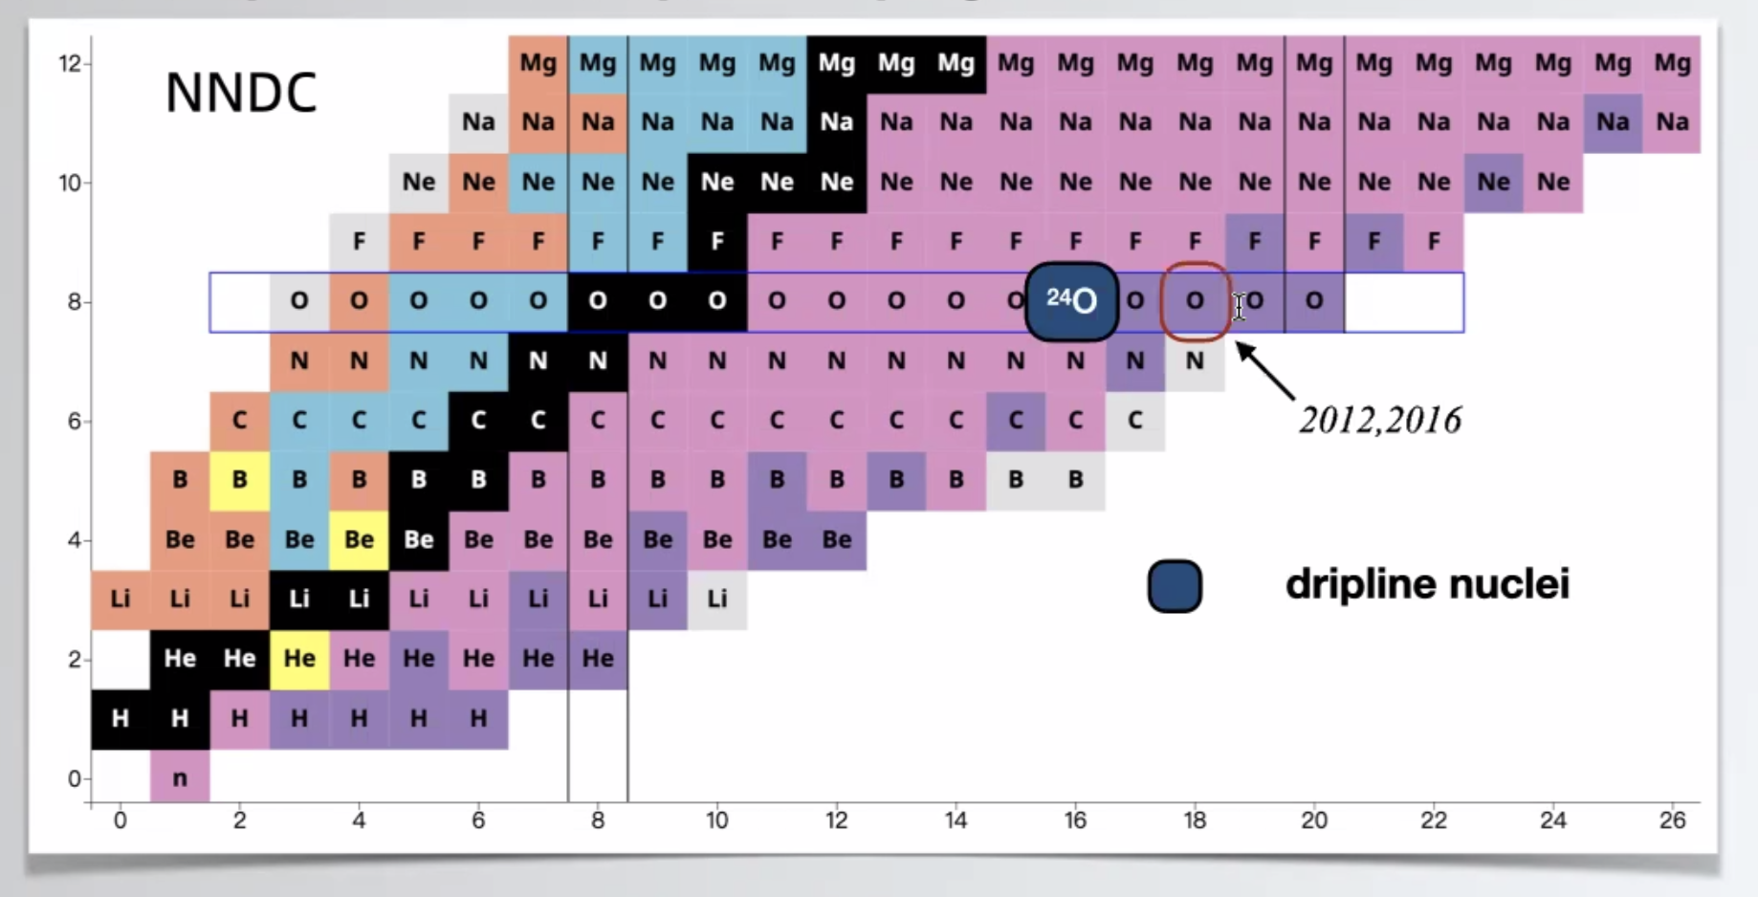
Dripline
Can we explain the dripline of Carbon, Oxygen isotopes in NLEFT?
Sensitive to nuclear force ? (Role of 3-body force?)

Slide 8
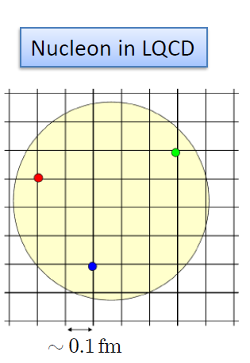
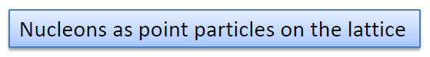
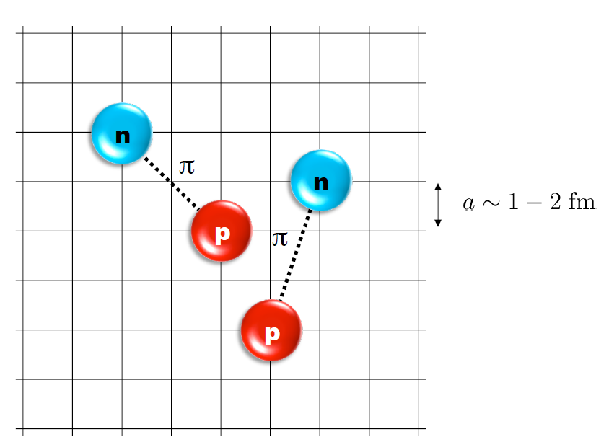
Nuclear Lattice Effective Field Theory
One of ab initio method for many fermion system

Slide 9
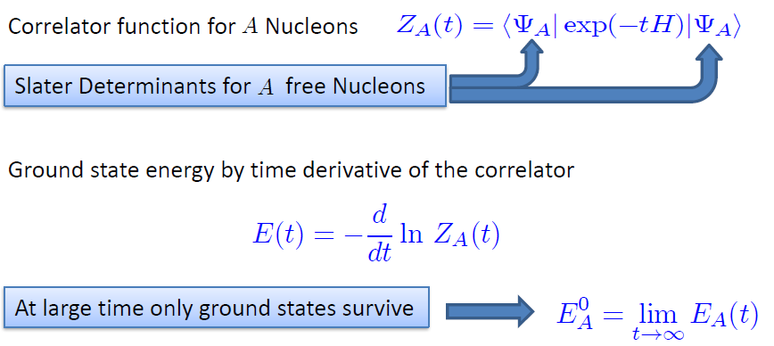
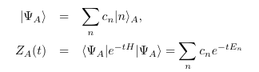
Path integral

Slide 10
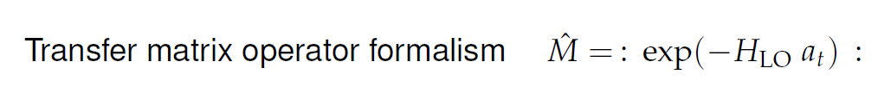
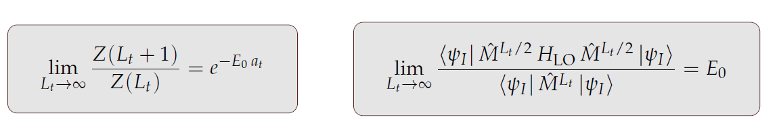
Transfer matrix
: O : represent Normal ordering.

Slide 11
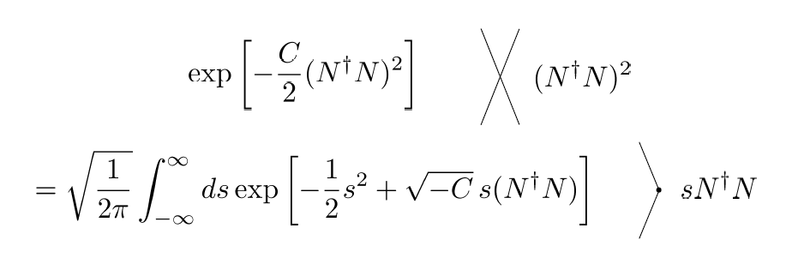
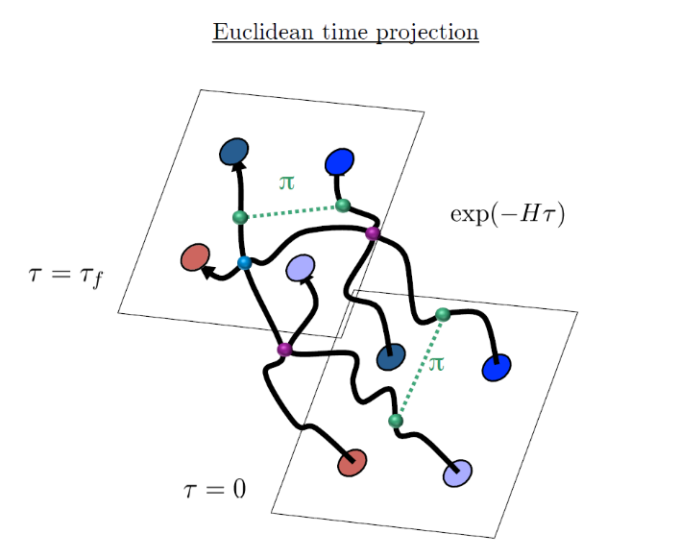
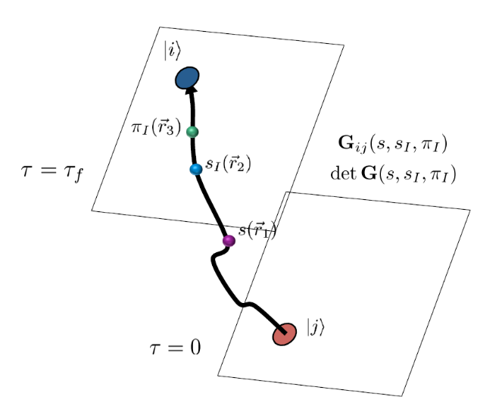
Auxiliary Field Monte Carlo
Interacting nucleons
Nucleons interacts with auxiliary fields
(no direct interaction between nucleons)
computing fermion
Correlator amplitude
Integration
over auxiliary fields
M.C. integral
(sampling auxiliary field)

Slide 12
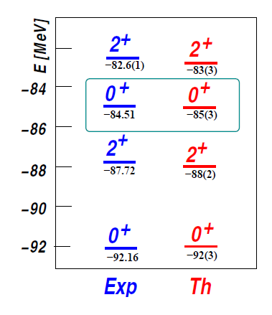
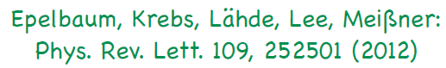
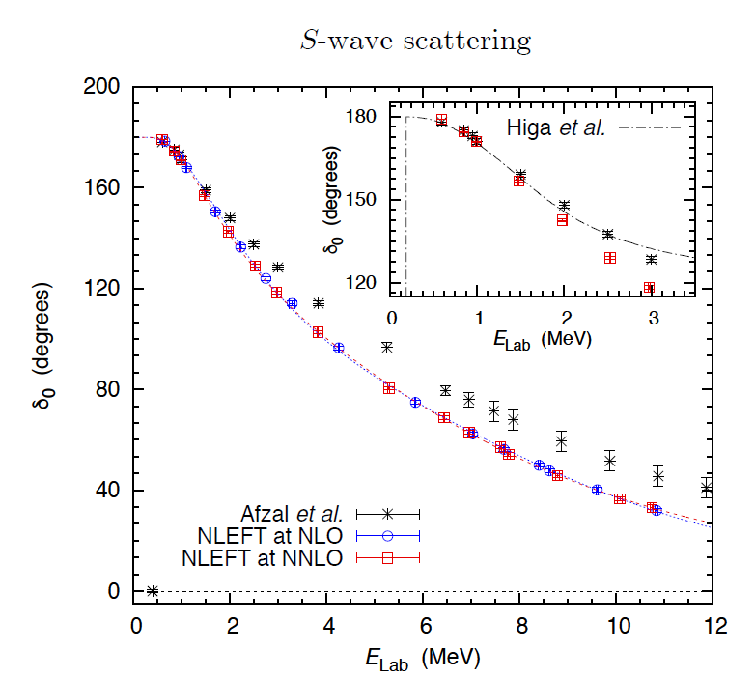
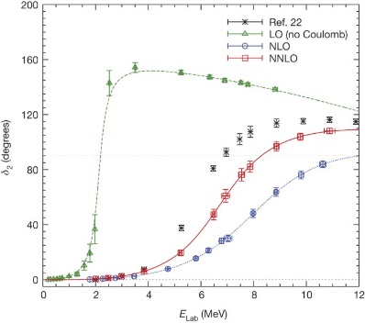
Applications of NLEFT
The first ab-initio calculation of
Hoyle state
Has been successfully applied to
Nuclear matter, Cold atom, dilute fermion system
Finite nuclei (A<=50)
First ab-initio calculation of Hoyle state
Cluster structure of ¹²C and ¹⁶O
NN scattering, N-D scattering
Alpha-alpha scattering
radiative capture, fusion
Etc.
Ab initio alpha-alpha scattering
( Nature 528, 111-114(2015))

Slide 13
Lattice Hamiltonian
We need to introduce a lattice scale in space and time:
momentum space cutoff ~ 150 MeV → lattice size a= 1.316 fm
Time cutoff ~ 1000 MeV
We need to determine coefficients of interaction for the lattice size. (regularization scale.)
Two-body interaction coefficients can be determined from phase shifts of np scattering.
Three-body interaction can be fixed from binding energy of A>=3.

Slide 14
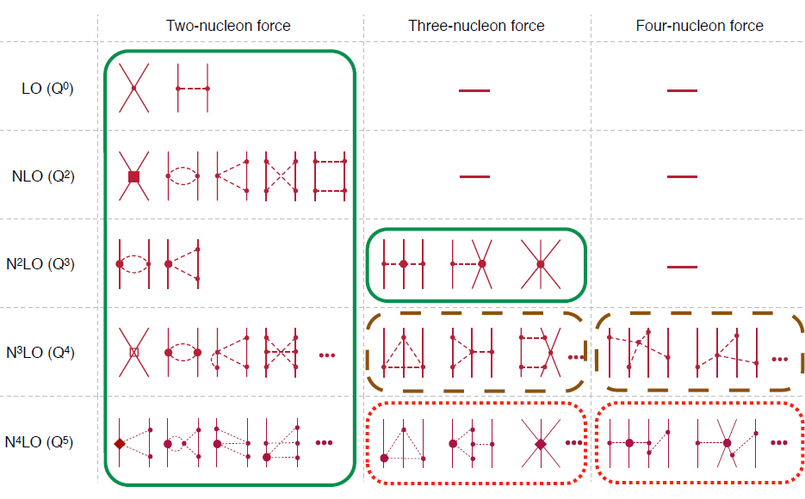
Chiral Effective Field Theory

Slide 15
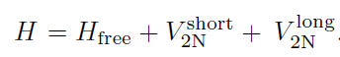
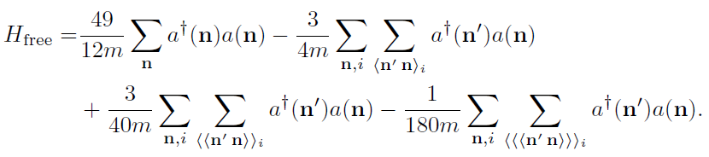
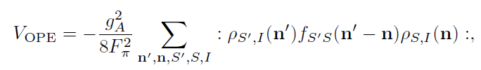
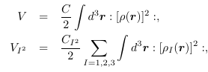
Lattice chiral Hamiltonian at Leading order
At Leading order, kinetic energy + contact interaction + one pion exchange
Kinetic
Long range OPE
Contact

Slide 16
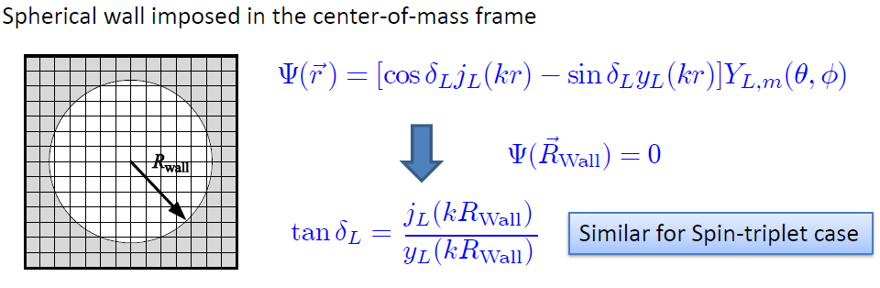
Low energy constants in lattice EFT
All LECs(parameters in the Hamiltonian) needs to be fixed
(They have to be fixed for given lattice regularization)
N-P scattering phase shifts, Deuteron binding energy
Scattering phase shifts on the Lattice: Wall method.
Phase shift can be obtained from
The energy spectrum of E(or k) in lattice and imposed Wall size.

Slide 17
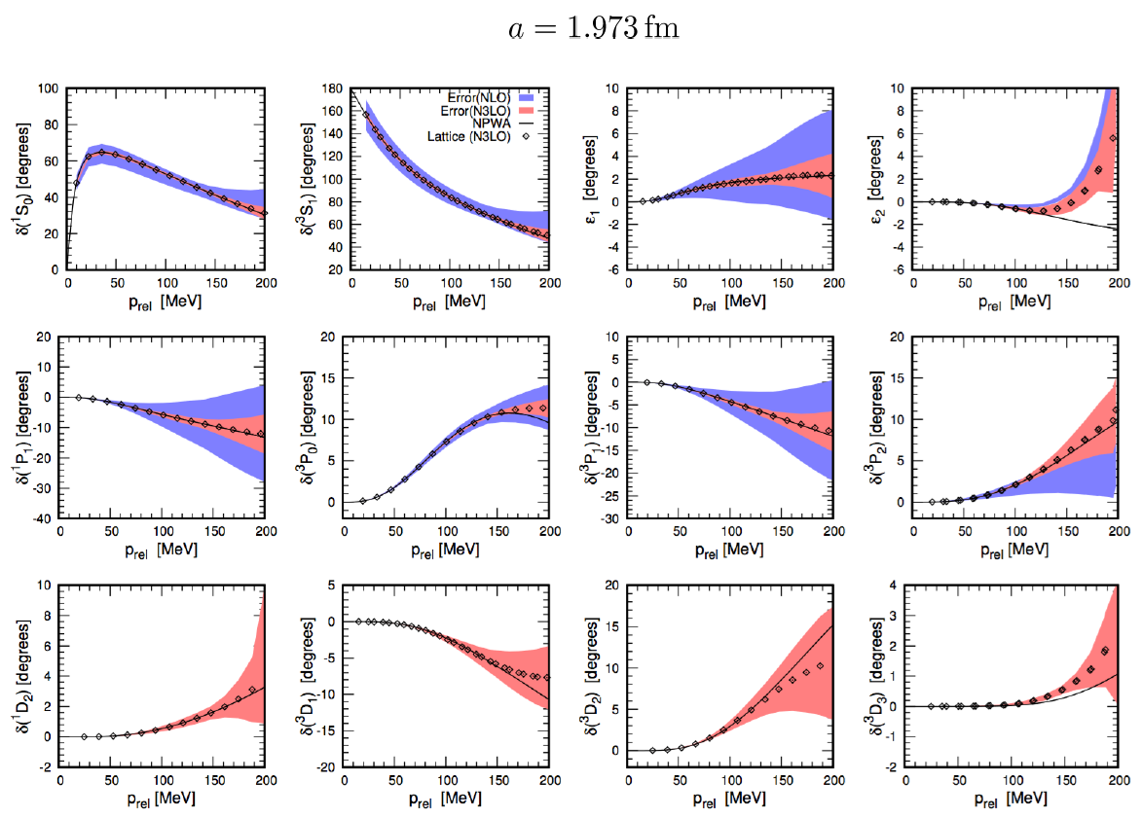
Determine LECs by fitting phase shifts of N-N scattering

Slide 18
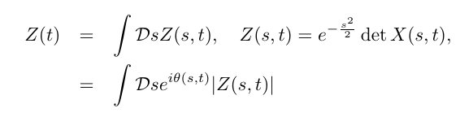
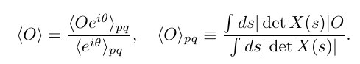
Sign problem in NLEFT
However, there is a difficulty in auxiliary MC calculation
We needs a large Euclidean time extrapolation
If the denominator’s sign oscillates rapidly
→ large uncertainty in the expectation value
→ sign problem
SU(4) symmetric interaction in isospin symmetric system
→ No sign problem

Slide 19
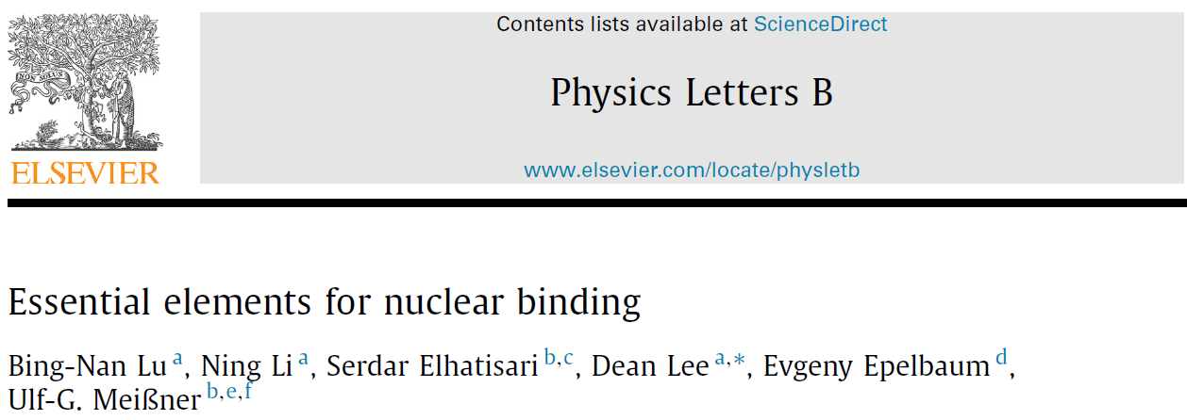
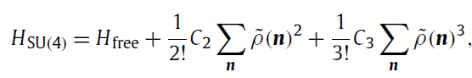
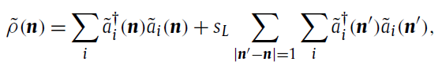
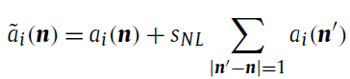
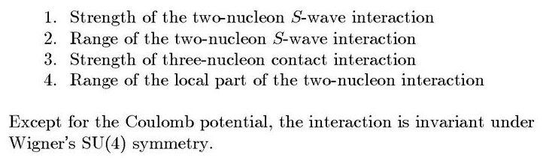
Minimal nuclear interaction
Which reproduce
Light nuclei
medium mass nuclei
neutron matter
simultaneously up to few percent error in binding energy and charge radius
Only Four parameters
No sign problem

Slide 20
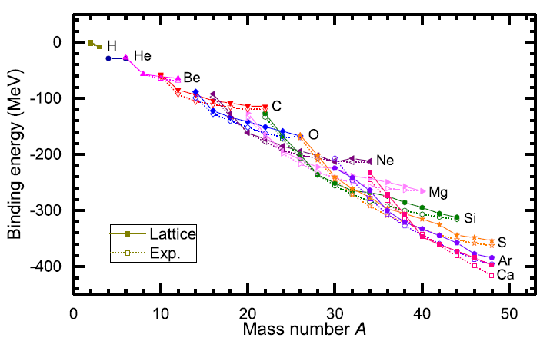
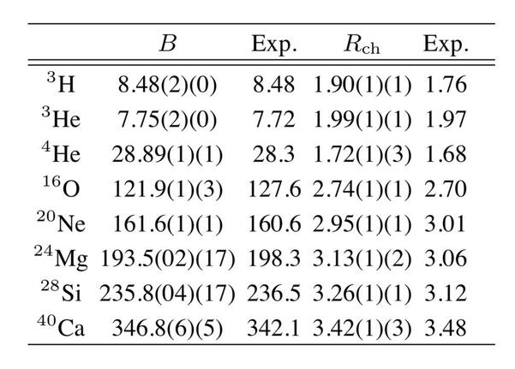
Can we improve the agreement by
Including higher order corrections?

Slide 21
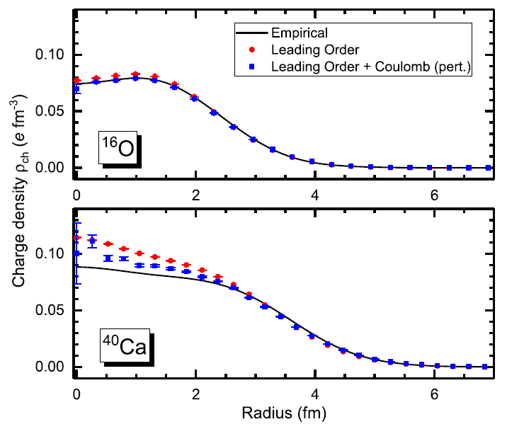
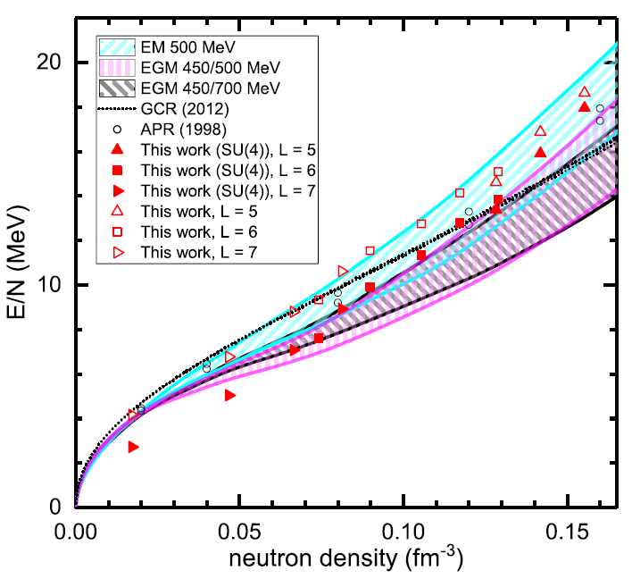
Can we improve the agreement by
Including higher order corrections?

Slide 22
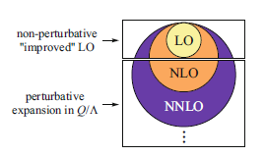
Lattice chiral Hamiltonian (N3LO)
Full N3LO Hamiltonian includes
Free Hamiltonian(Kinetic term)
Short range (nonlocal smeared) contact interactions up to Q^4 order
Isospin-breaking short range interactions
One pion exchange potential
Two pion exchange potential up to Q^4 order
Coulomb interaction
Long range isospin breaking interaction( isospin dependence in OPE)
Galilean Invariance Restoration (GIR) term (because of non-local interaction.)
Three nucleon interaction

Slide 23
Difficulty with full chiral interaction
Sign problem
NLEFT suffers sign problems at large Euclidean time limit
Large cancellation between positive and negative contributions→ large uncertainty.
SU(4) symmetric interaction does not have sign problem
One pion exchange and higher order chiral interaction, short range repulsion
Difficulty with Asymmetric nuclei
Needs a remedy to extend to neutron rich isotopes.
A new approach to reduce the sign problem.
→ Wave function matching Hamiltonian.

Slide 24
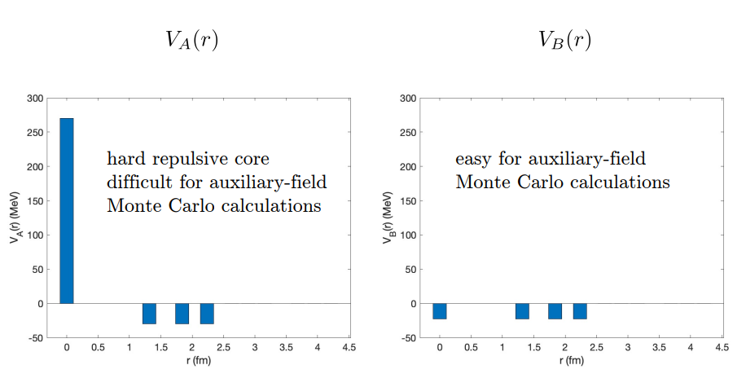
Wave Function Matching
From presentation file by Dean Lee

Slide 25
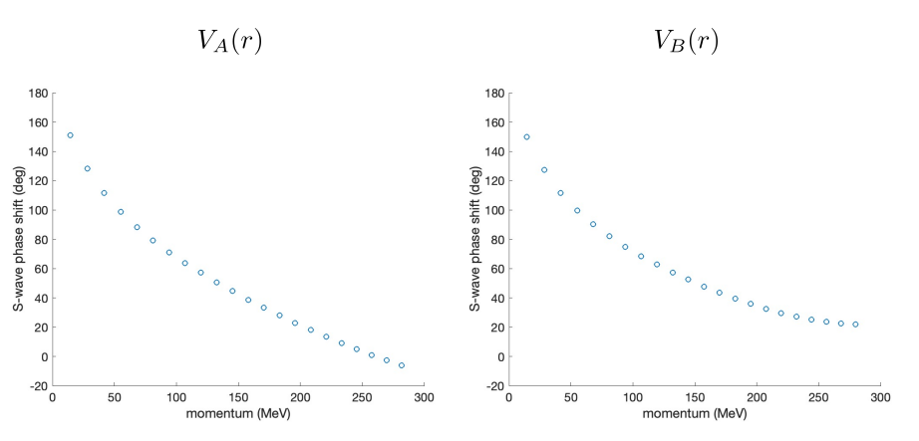
Wave Function Matching
Phase shifts from two interactions
From presentation file by Dean Lee

Slide 26
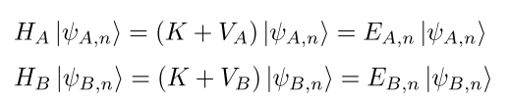
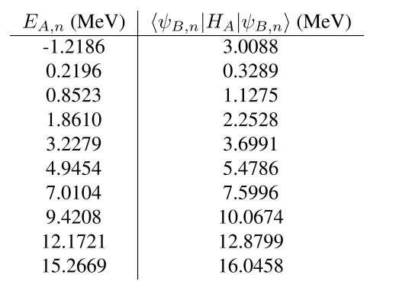
Wave Function Matching
Compute eigen energy of H_A
Using wave function of H_B
In 1st order perturbation theory
→ Does not work !
From presentation file by Dean Lee

Slide 27
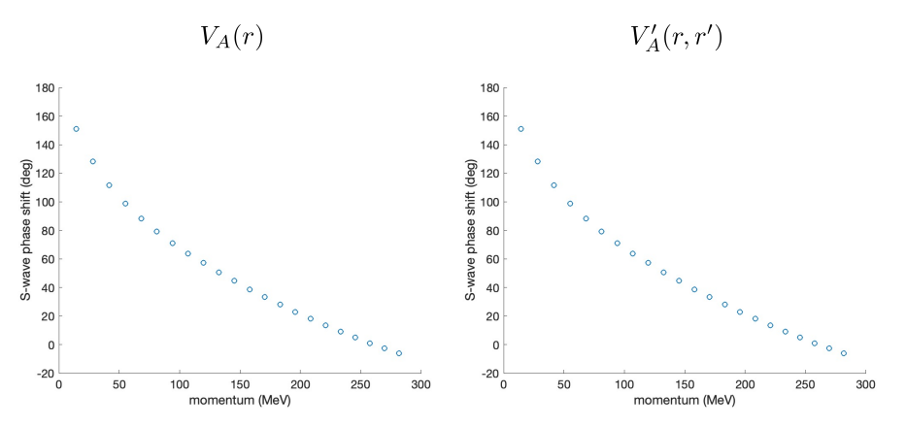
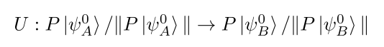
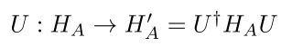
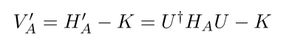
Wave Function Matching
Introduce short range Unitary transformation
Two potentials V_A and V’_A are unitarily equivalent.
→ Same phase shifts.
From presentation file by Dean Lee

Slide 28
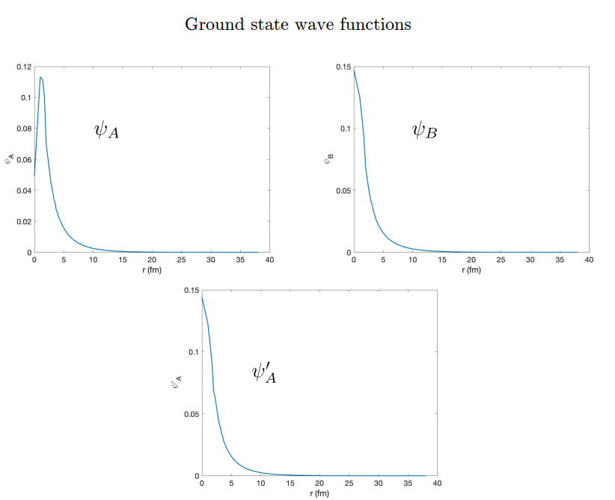
Wave Function Matching
Wave function psi’_A
: similar to psi_B
at short distance
From presentation file by Dean Lee

Slide 29
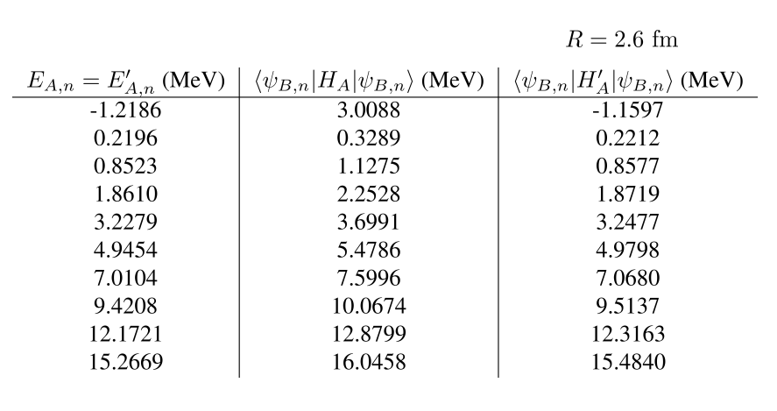
Wave Function Matching
Energy from Perturbation theory with H’_A works better.
Difference H_A- H’_A can be treated as a correction.
From presentation file by Dean Lee

Slide 30
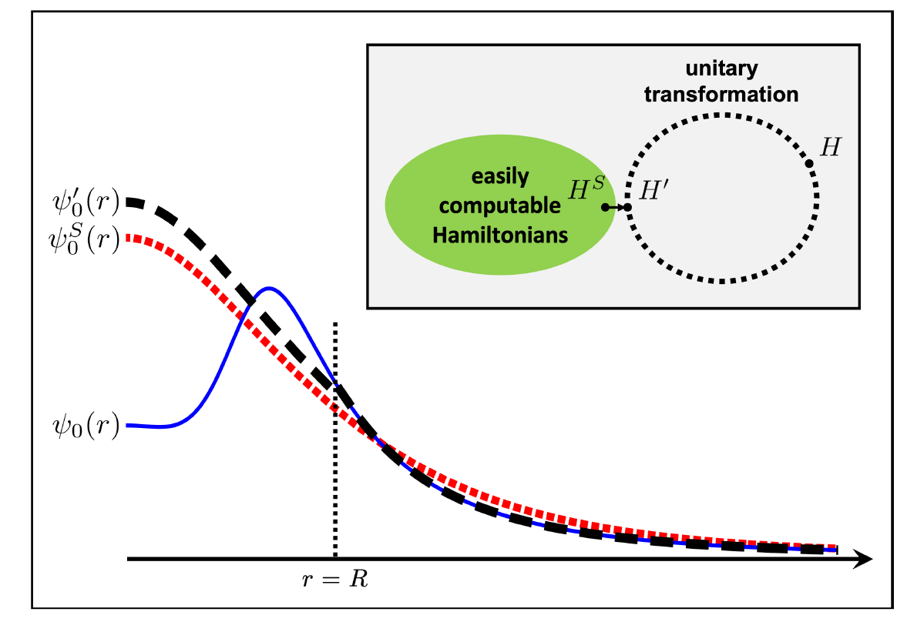
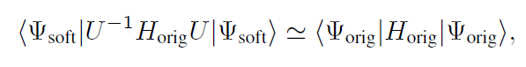
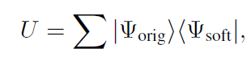

Wave function matching
H and H’ are fully equivalent to two-body observables
The goal is to make the perturbation expansion from “simple” wave function gives a good convergence
U is only active
At r < R

Slide 31


NN phase shifts from WFM
Original Chiral Hamiltonian is fitted to phase shifts. (up to N3LO)
H’ is equivalent to original Hamiltonian.

Slide 32



Wave function matching Hamiltonian
“Simple” Hamiltonian
(local,non-local smeared operators)

Slide 33

Wave function matching Hamiltonian
N3LO Hamiltonian
V_2N : short range NN interactions
W_2N: GIR restoration term for V_2N
V_2N,WFM : difference from H’-H
W_2N,WFM: GIR restoration correction to V_2N,WFM
V_3N : contains short range 3N interaction parameters(to be fitted)
and two pion exchange correction to 3N

Slide 34

Wave function matching
Deuteron:
< H’ > = 2.02 MeV
exact H : 2.21 MeV
Difference due to higher order
correction of H’-H_S.
Tjon band : correlations in
H3 and He4 binding energy
(no 3-body force yet)

Slide 35

Wave function matching
Tjon band for LO, NLO, N3LO
For various wave function matching radius R.
→ Results R > 2.7 fm are independent of R.

Slide 36



Tale of two interactions
Nearly identical two interactions can give quite different phase:
sensitivity to range and locality of interaction
Very different alpha-alpha scattering
PRL 117, 132501 (2016)
From presentation file by Dean Lee

Slide 37










3-body force
NNLO
At N3LO:
TPE and
Adjustments to
cD and cE terms.

Slide 38


3-body force
Tune 3-body interaction to minimize errors
in binding energy
Just one additional parameter,
RMSD for the E/A
drops from 1.2 MeV to 0.4 MeV
Energies
Significant sensitivity to
the locality of 3N interactions.
We interpret they are related with
effective interactions
between alphas and nucleons.
Significantly high w/o additional 3-body terms
: alpha-alpha should be more attractive.

Slide 39

Determine 3-body force
RMSD (MeV/nucleon): 1.2 → 0.3 →0.109 → 0.079

Slide 40

BE/A from WFM
RMSD ~ 0.1 MeV per nucleon

Slide 41



Charge density from WFM
Preliminary

Slide 42

Charge Radius
No fitting! RMSD~ 0.03 fm

Slide 43

Nuclear/Neutron Matter
Neutron matter:
A=4~80
box size 6.6 ~ 13.2 fm.
Nuclear matter:
A=4 ~ 160
Box size 7.92~9.24 fm.
Uncertainties from
finite system size correction

Slide 44

Carbon isotopes

Slide 45

Carbon and Oxygen
Preliminary

Slide 46
Summary
Wave function matching method seems to be promising
New method to improve the N3LO calculation of NLEFT
Preliminary study shows promising results for wide range of observables in one scheme (same interaction and many-body method)
NN scattering
Binding energy (from 3H to 40Ca)
Symmetric Nuclear matter
Neutron matter
Dripline of Oxygen isotope.
Carbon excited states
Also, Carbon isotopes, odd Oxygen isotopes, Cluster structure, excited states will be studied.

